Slide 1



BEFIB 2024 XI International Symposium on Fiber Reinforced Concrete September 15-18, 2024
Numerical Simulation of Splitting and Spalling Fracture in Steel Fibre Reinforced Structural Elements
IIT
MADRAS
Dr. Keerthana Kirupakaran, Assistant Professor
Mr. Manas Bhadury, M.S. student
Dr. Giuseppe Tiberti, Associate Professor
Dr. Ivan Trabucchi, Post-doctorate
Dr. Giovanni Plizzari, Full Professor
Mr. Filippo Medeghini, PhD student
Dr. Peter Mark, Full Professor

Slide 2
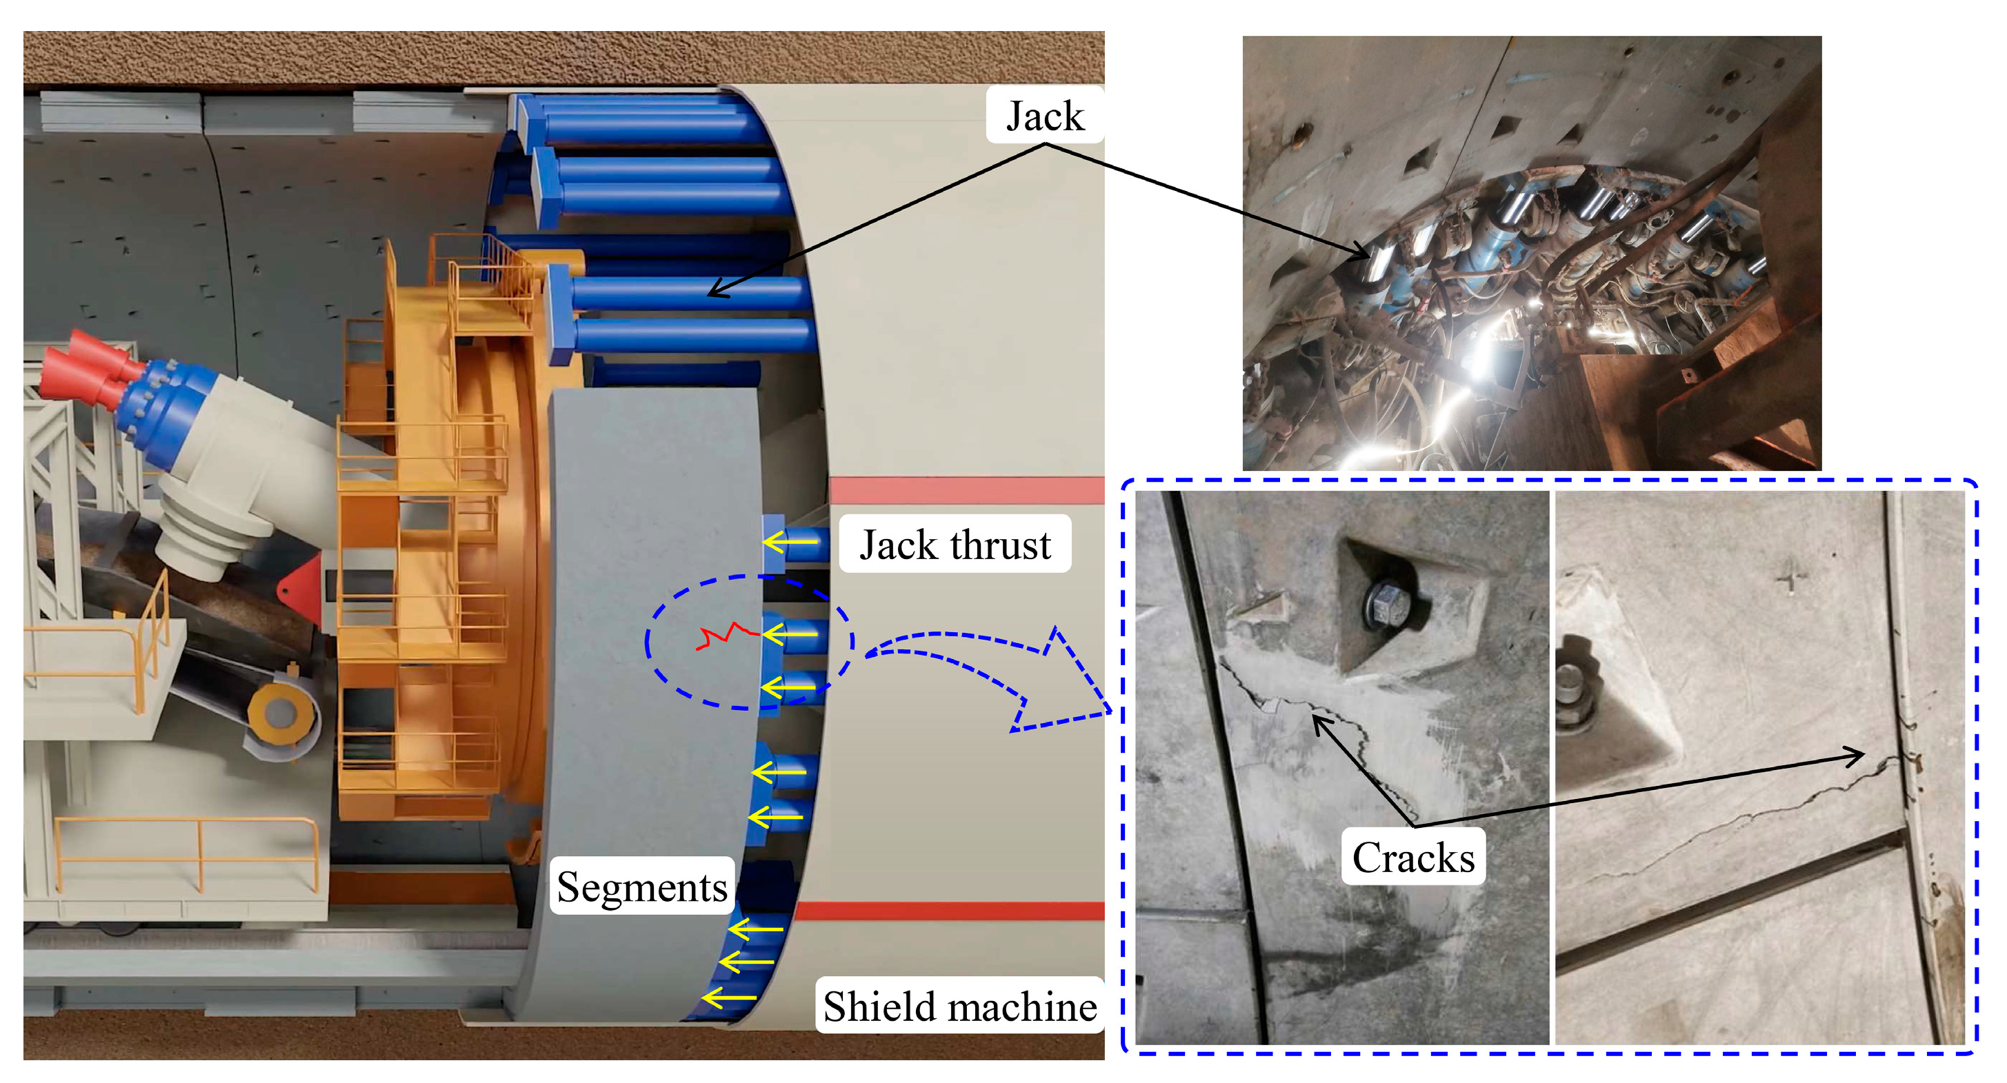
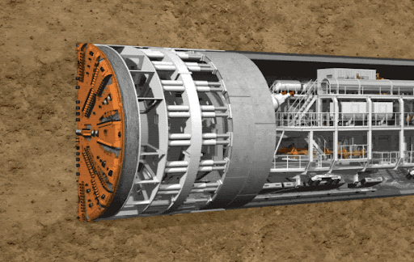
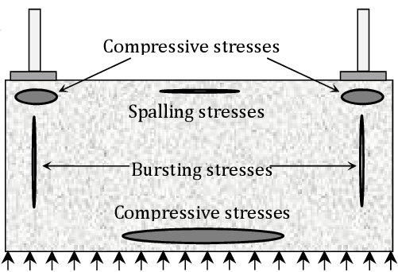
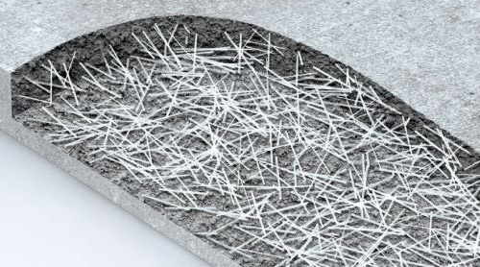
Background
Xu et al. 2023
https://www.reddit.com/r/MachinePorn/comments/125ilo9/tunnel_boring_machine_tbm/
Splitting and spalling cracks
Steel Fibre Reinforced Concrete
Spalling stresses
Splitting stresses
Better crack width control
Faster production compared to RCC segment
Challenges?
Lin et al. 2015
https://www.surechemical.com/aboutus/RP20230823-Fiber-Reinforced-Concrete.html
Notes:
the cost of AR-glass textiles is about five to six times that of conventional E-glass textiles due to the incorporation of zirconia and the higher energy requirements during manufacturing.

Slide 3
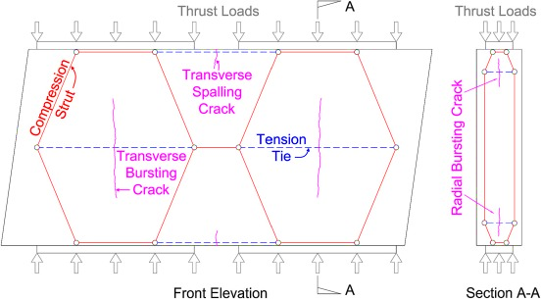
Challenges & Objective
Steel Fibre Reinforced Concrete
Unlike conventional RCC, Design of SFRC - Fracture mechanics principles
Accurate estimation of splitting and spalling stress
Spatial optimization for steel fibre dosage in SFRC
Strut and Tie – Elastic analysis – Does not give an accurate prediction of stress for SFRC
Mechanical performance of spatially optimized SFRC?
Full-scale testing
Non-linear finite element simulations
Expensive
Time consuming
Large scale testing facility
Not straight forward
Material constitutive law
Convergence issues
Ouyang et al. 2023
OBJECTIVE
Experimentally and Numerically assess the spatially optimized SFRC structural elements
Notes:
the cost of AR-glass textiles is about five to six times that of conventional E-glass textiles due to the incorporation of zirconia and the higher energy requirements during manufacturing.

Slide 4
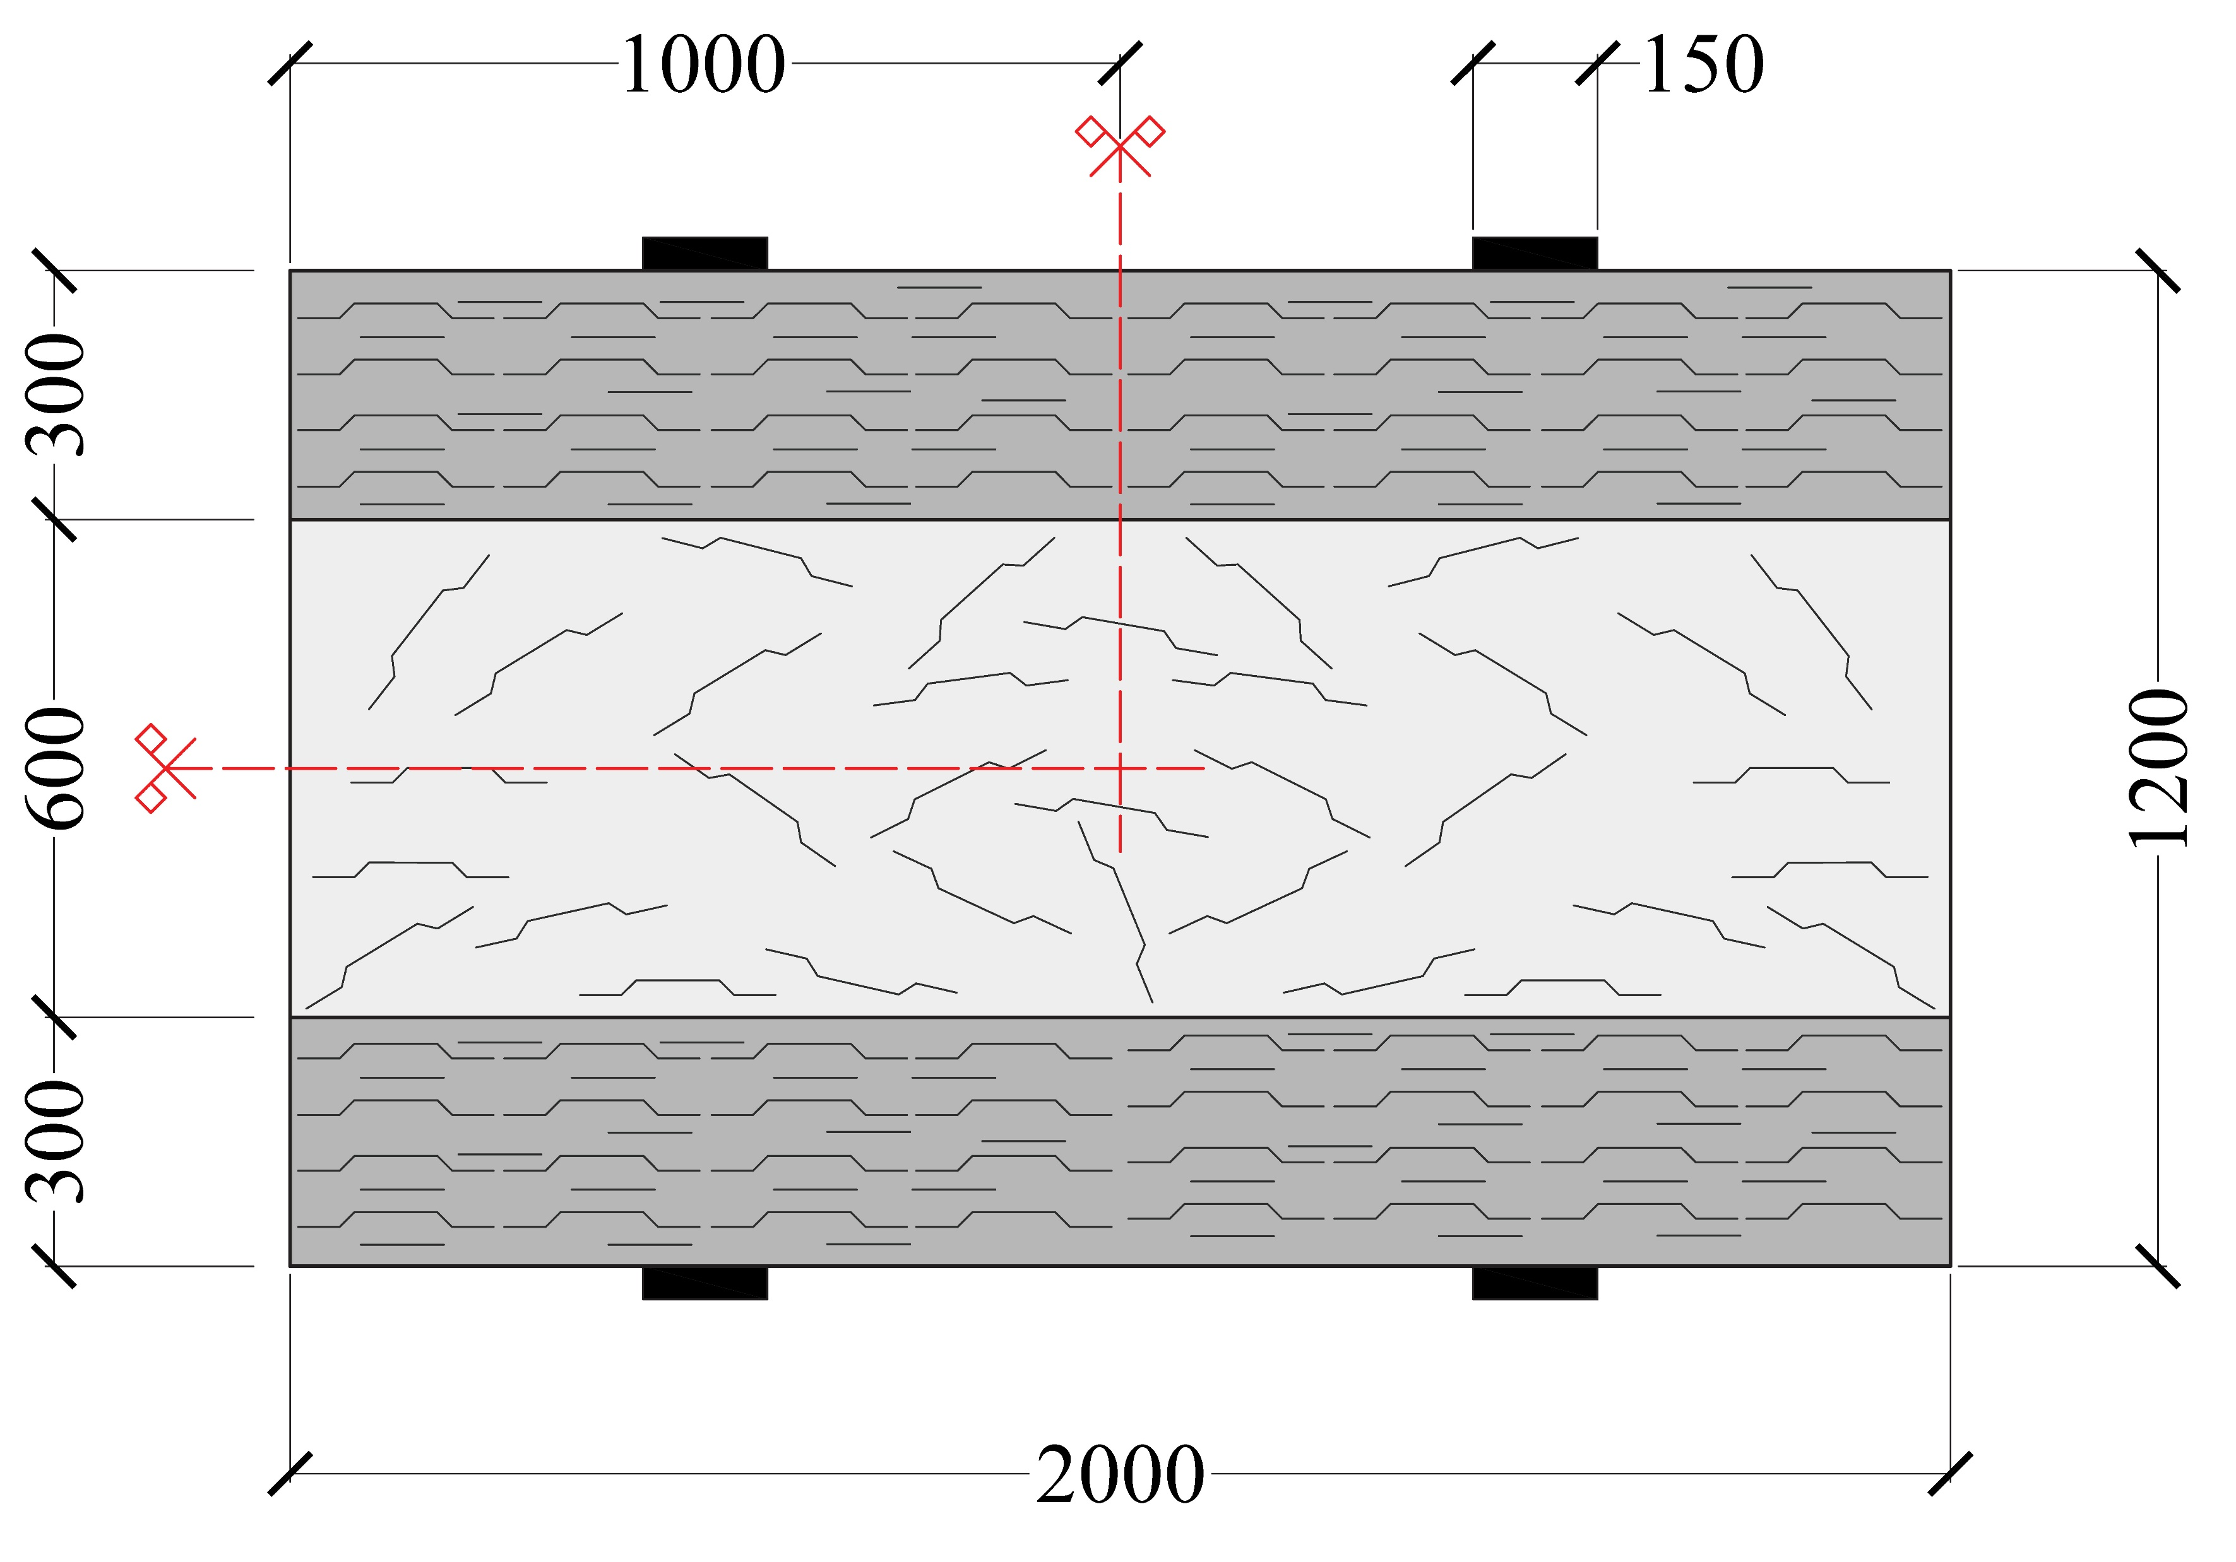
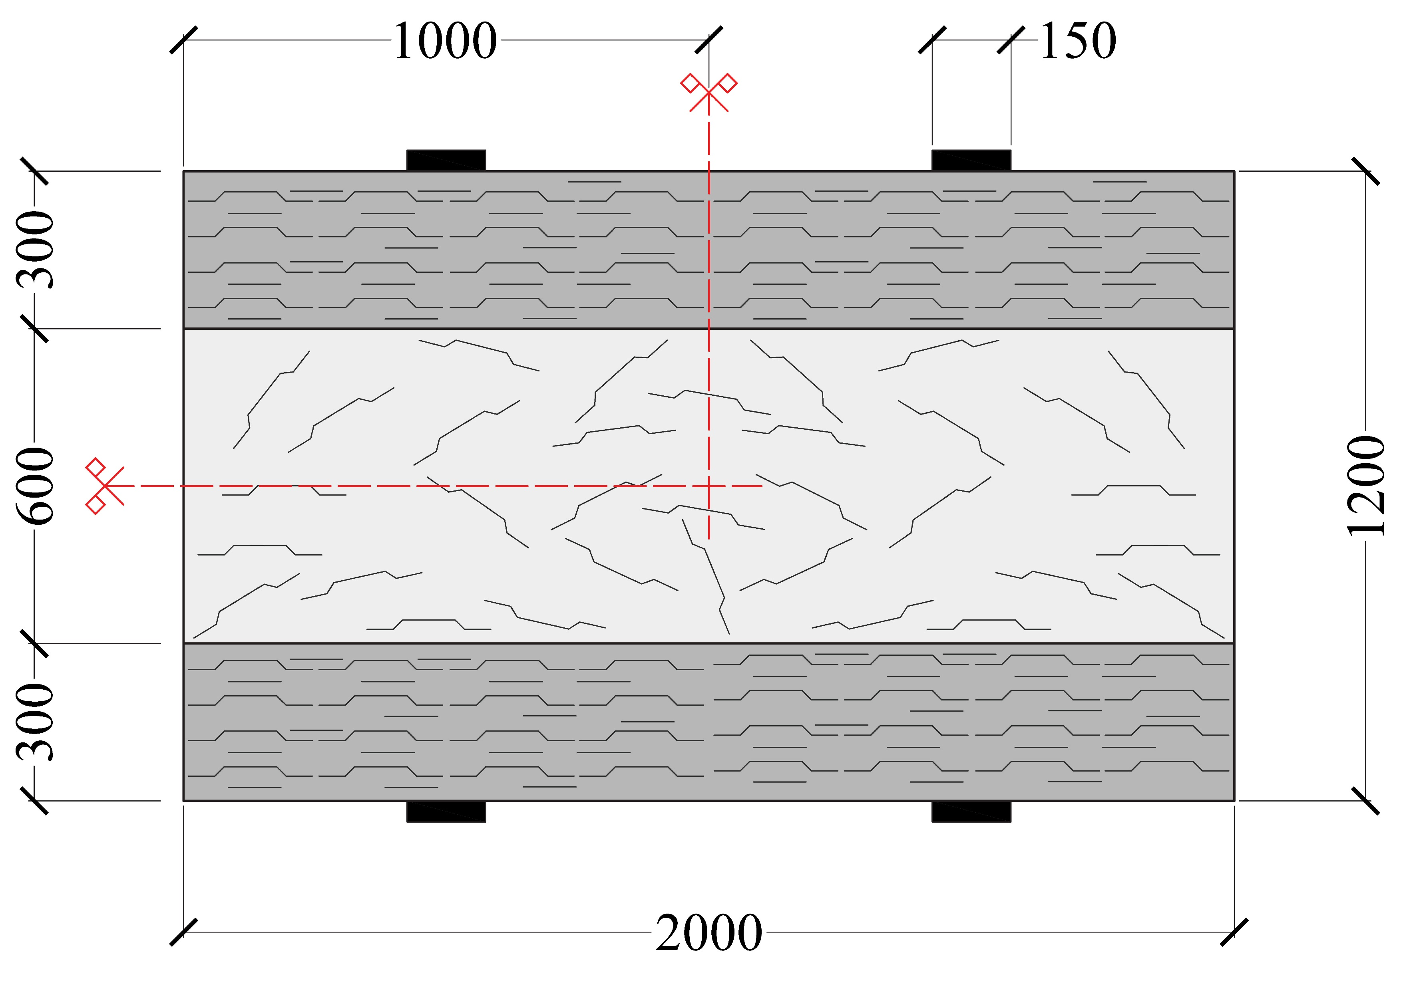


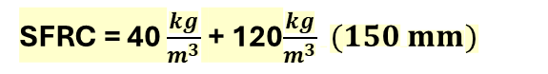

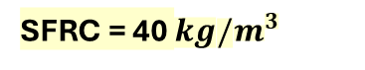
Specimen details
Thickness = 150 mm
SFRC = 40 $\frac{kg}{m^{3}}$ + 120$\frac{kg}{m^{3}} (150 mm)$
(NPFRC)
(HPFRC)
SFRC = 40 $\frac{kg}{m^{3}}$ + 120$\frac{kg}{{ m}^{3}}(300 mm)$
SFRC = 40 $kg/m^{3}$
HPFRC 60+60 kg/m³ - Hybrid
Steel micro +macro fibers
Straight, 13 mm long, 0.2 mm in diameter
Tensile strength = 3050 MPa
Steel macro fibers
Hooked-end, 35 mm long, 0.55 mm in diameter
Tensile strength = 1345 MPa
(NPFRC)
150
NPFRC
Steel macro fibers
Hooked-end, 35 mm long, 0.55 mm in diameter
Tensile strength = 1345 MPa
900
150
Notes:
the cost of AR-glass textiles is about five to six times that of conventional E-glass textiles due to the incorporation of zirconia and the higher energy requirements during manufacturing.

Slide 5
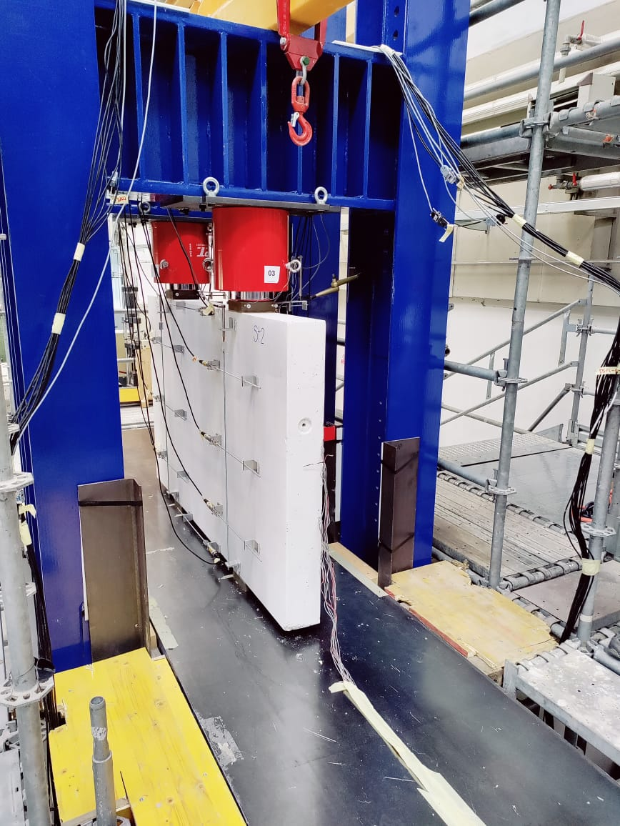



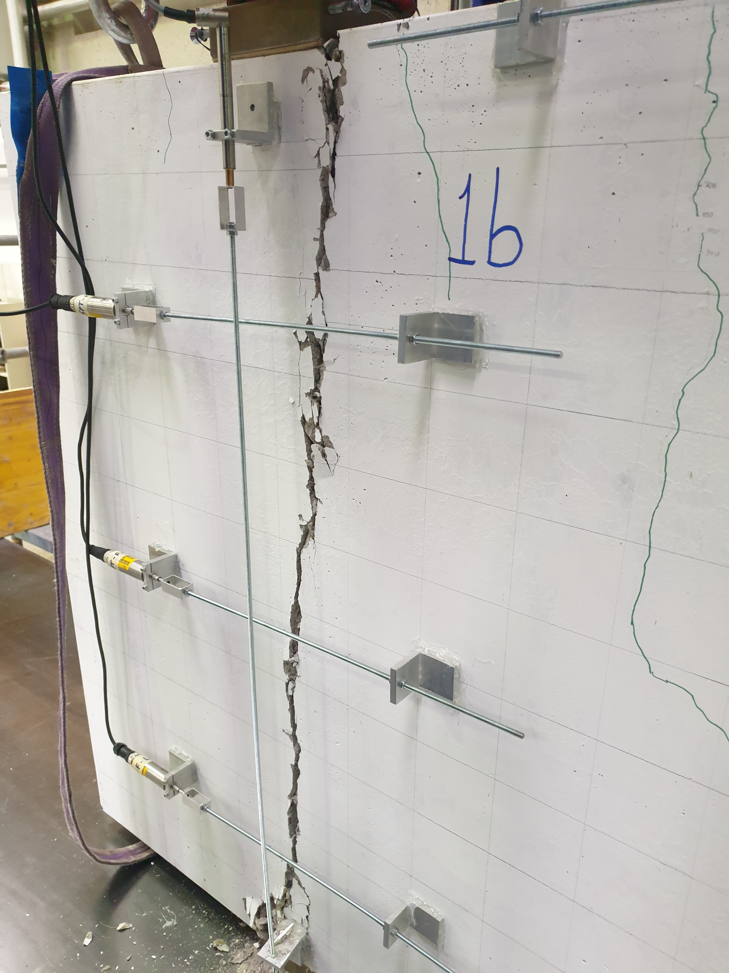
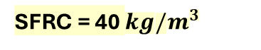
Loading details
P
P
Instrumentation
4 LDTs 25 mm
12 LDTs 10 mm
4 LVDTs 10 mm
P
P
Specimen was loaded until failure
SFRC = 40 $kg/m^{3}$
(NPFRC)
Specimen failed under due to tensile splitting
Structural engineering lab at UNIBS
Notes:
the cost of AR-glass textiles is about five to six times that of conventional E-glass textiles due to the incorporation of zirconia and the higher energy requirements during manufacturing.

Slide 6

Numerical Modelling
Key elements
Modelling assumptions
2D model
Plane stress elements
Smeared crack approach
Material input parameters
Compressive strength, tensile strength, modulus of elasticity – from experiments & standards
Uniaxial tensile constitutive law – from inverse analysis
Mesh size: mesh convergence analysis
Loading and support conditions
Analysis input parameters
Numerical results and validation
Notes:
the cost of AR-glass textiles is about five to six times that of conventional E-glass textiles due to the incorporation of zirconia and the higher energy requirements during manufacturing.

Slide 7
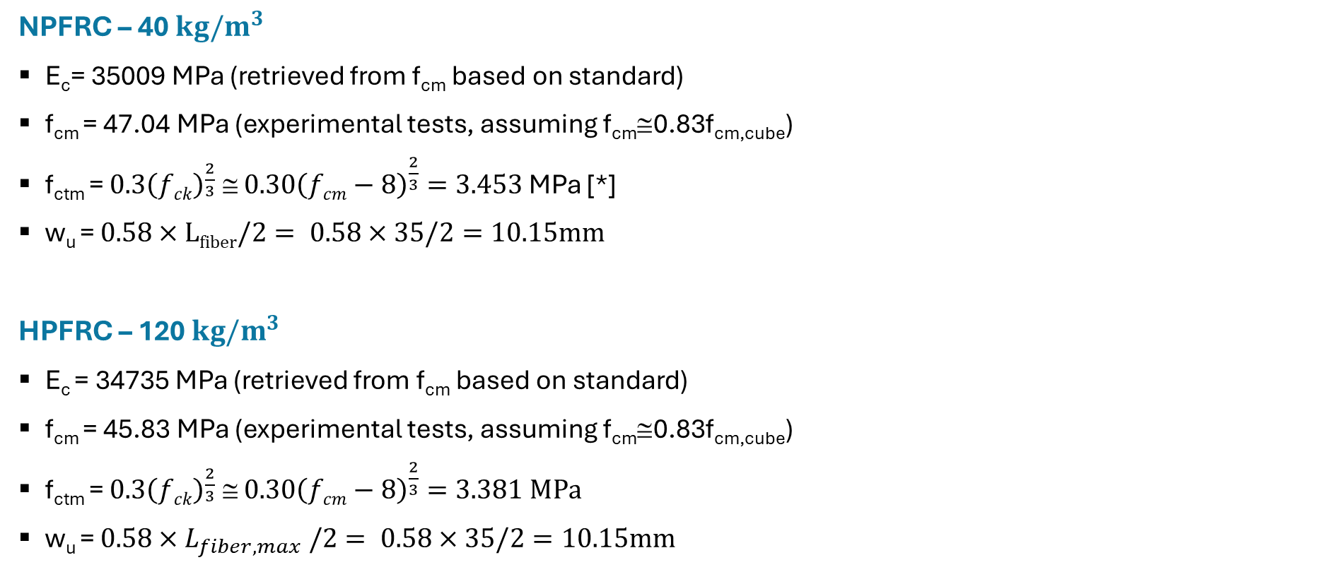
Numerical Modelling
Material input parameters
NPFRC – 40 $kg/m^{3}$
E_{c}= 35009 MPa (retrieved from f_{cm} based on standard)
f_{cm} = 47.04 MPa (experimental tests, assuming f_{cm}≅0.83f_{cm,cube})
f_{ctm} = $0.3{\left(fck\right)}^{\frac{2}{3}} ≅ 0.30{\left(fcm−8\right)}^{\frac{2}{3}}=3.453$MPa [*]
w_{u} = $0.58×Lfiber/2= 0.58×35/2=10.15mm$
HPFRC – 120 $kg/m^{3}$
E_{c} = 34735 MPa (retrieved from f_{cm} based on standard)
f_{cm} = 45.83 MPa (experimental tests, assuming f_{cm}≅0.83f_{cm,cube})
f_{ctm} = $0.3{\left(fck\right)}^{\frac{2}{3}} ≅ 0.30{\left(fcm−8\right)}^{\frac{2}{3}}=3.381 MPa$
w_{u} = $0.58×L_{fiber,max} /2= 0.58×35/2=10.15mm$
Notes:
the cost of AR-glass textiles is about five to six times that of conventional E-glass textiles due to the incorporation of zirconia and the higher energy requirements during manufacturing.

Slide 8
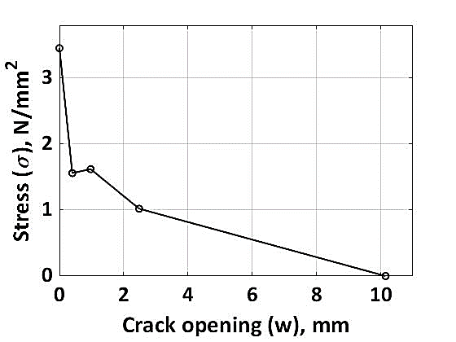
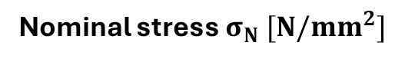
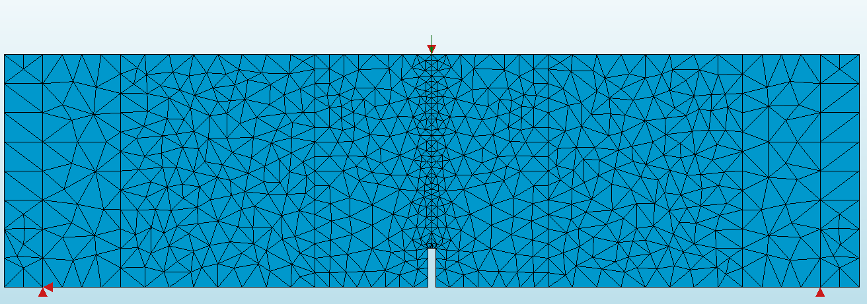
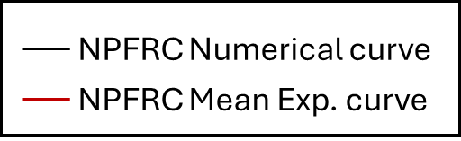
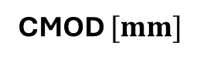
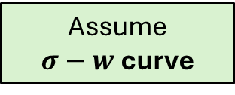
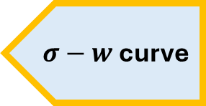
Numerical Modelling
Constitutive law- Inverse analysis
Iterative process
Notch beam experiment
Material uniaxial tensile constitutive law
$σ−w$ curve
Inverse Analysis
Comparison
Assume
$σ−w$ curve
Notch beam model – discrete crack approach
DiANA 10.6 software
Interface element: L8IF
Notes:
the cost of AR-glass textiles is about five to six times that of conventional E-glass textiles due to the incorporation of zirconia and the higher energy requirements during manufacturing.

Slide 9

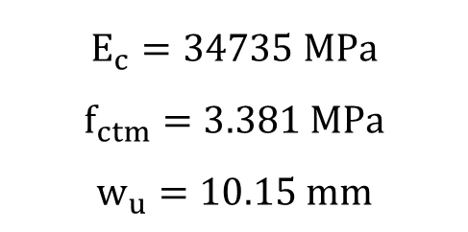

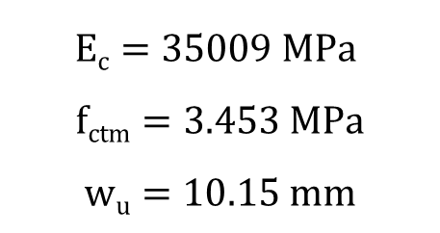
Numerical Modelling
Constitutive law- Inverse analysis
N$PFRC 40 kg/m^{3}(Lfiber=35mm)$
$HPFRC 120 kg/m^{3}$($L_{fiber}=35mm$)
$$Ec=35009 MPa$$
$$fctm=3.453 MPa$$
$$wu=10.15 mm$$
w | σ
mm | MPa
0 | 3.453
0.023 | 1.56
0.97 | 1.62
2.48 | 1.02
10.15 | 0
$$E_{c}=34735 MPa$$
$$f_{ctm}=3.381 MPa$$
$$w_{u}=10.15 mm$$
w | σ
mm | MPa
0 | 3.381
0.01 | 2.83
0.3 | 3.4
2.42 | 1.9
10.15 | 0
Notes:
the cost of AR-glass textiles is about five to six times that of conventional E-glass textiles due to the incorporation of zirconia and the higher energy requirements during manufacturing.

Slide 10
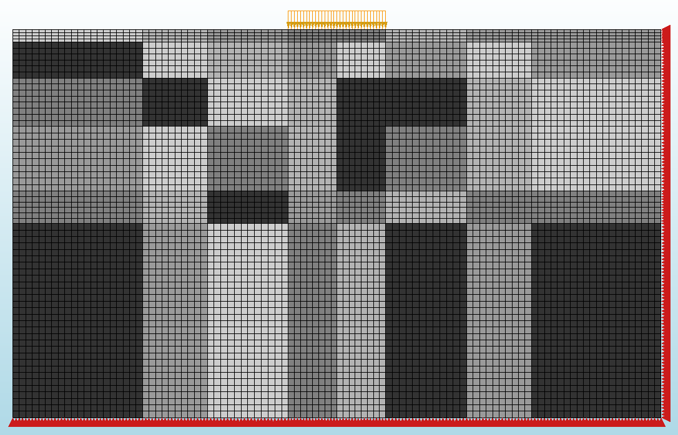
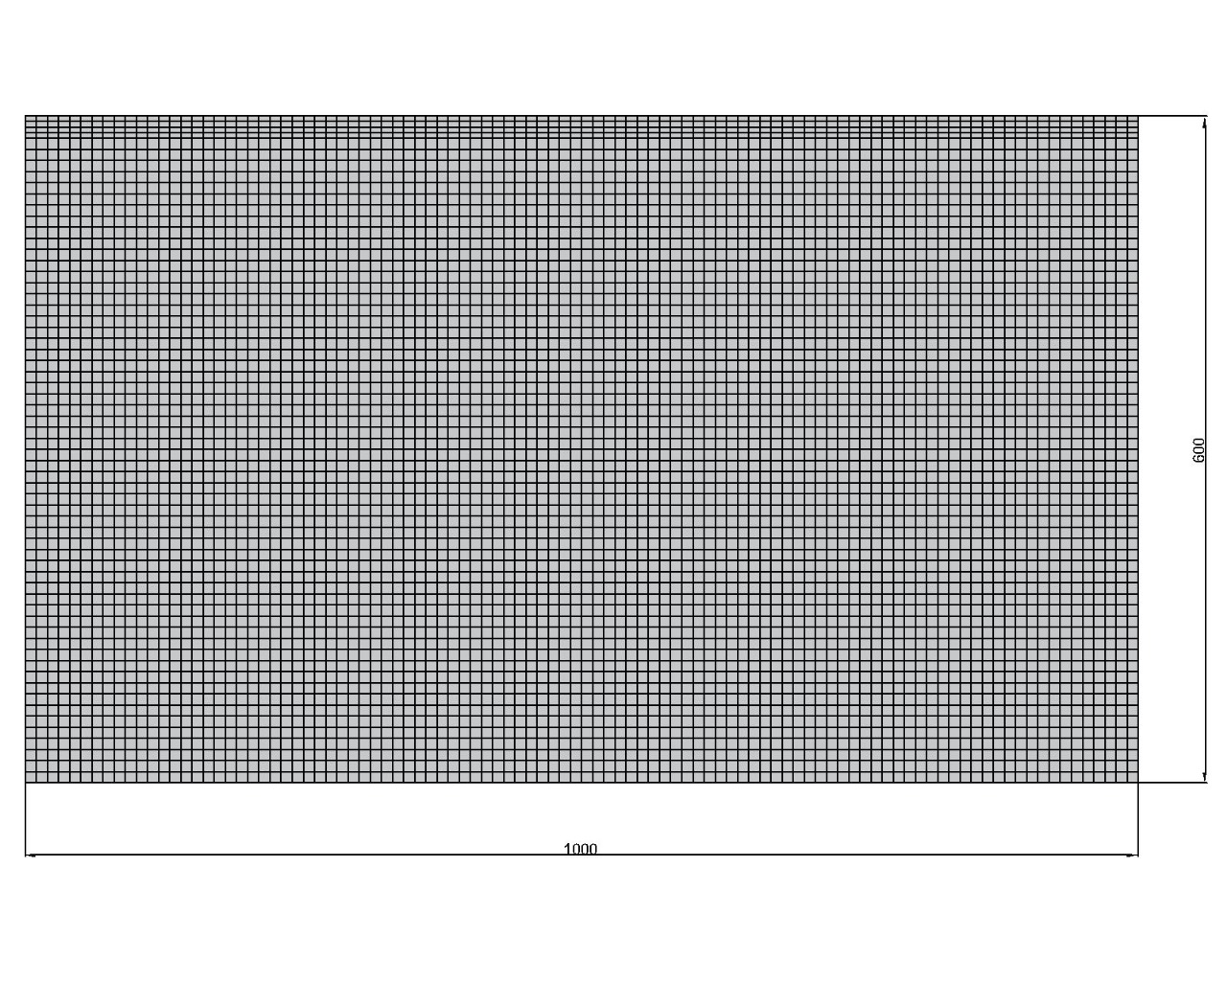
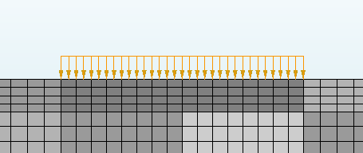
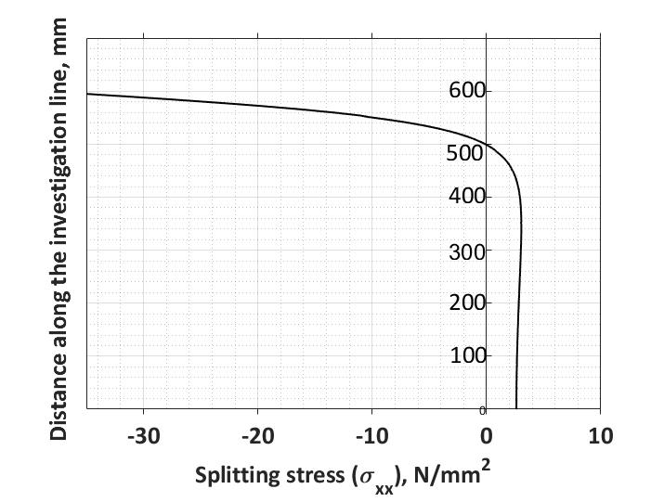
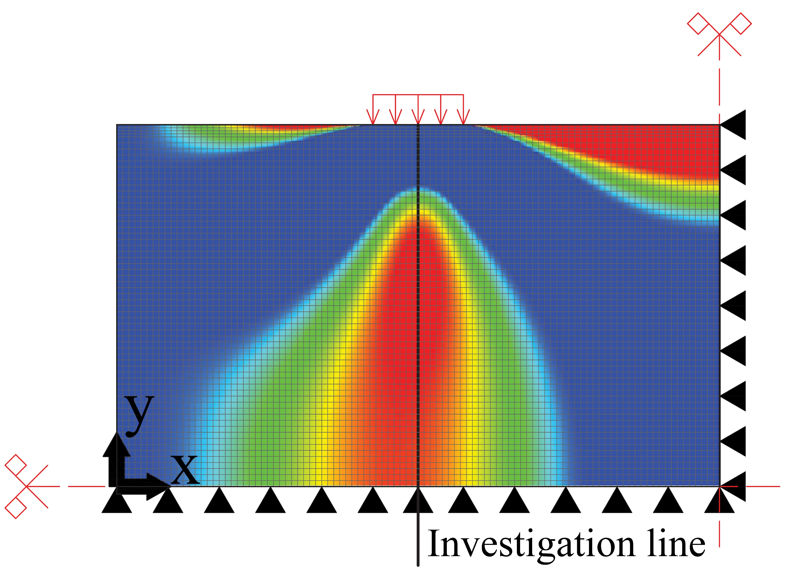
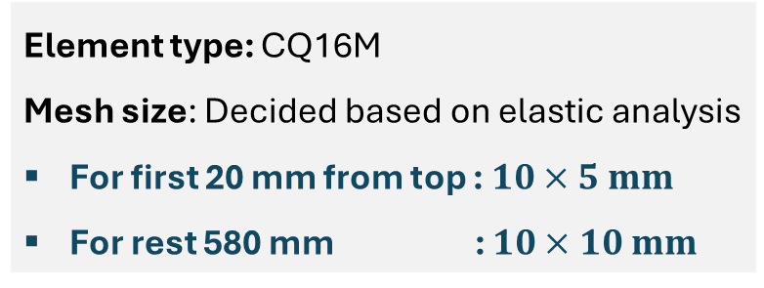
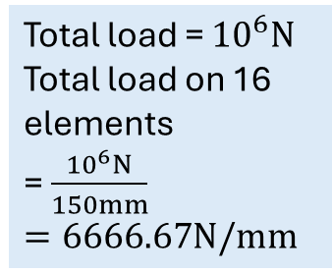
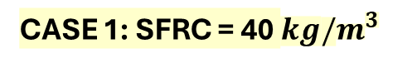
Numerical Modelling
SFRC rectangular segment
150
CASE 1: SFRC = 40 $kg/m^{3}$
Total load = ${10}^{6}N$
Total load on 16 elements
= $\frac{{10}^{6}N}{150mm}$
$=6666.67N/mm$
150
Both X and Y-translation: restrained
Y
X
Only Y-translation: restrained
Element type: CQ16M
Mesh size: Decided based on elastic analysis
For first 20 mm from top : $10×5 mm$
For rest 580 mm : $10×10 mm$
Notes:
the cost of AR-glass textiles is about five to six times that of conventional E-glass textiles due to the incorporation of zirconia and the higher energy requirements during manufacturing.

Slide 11
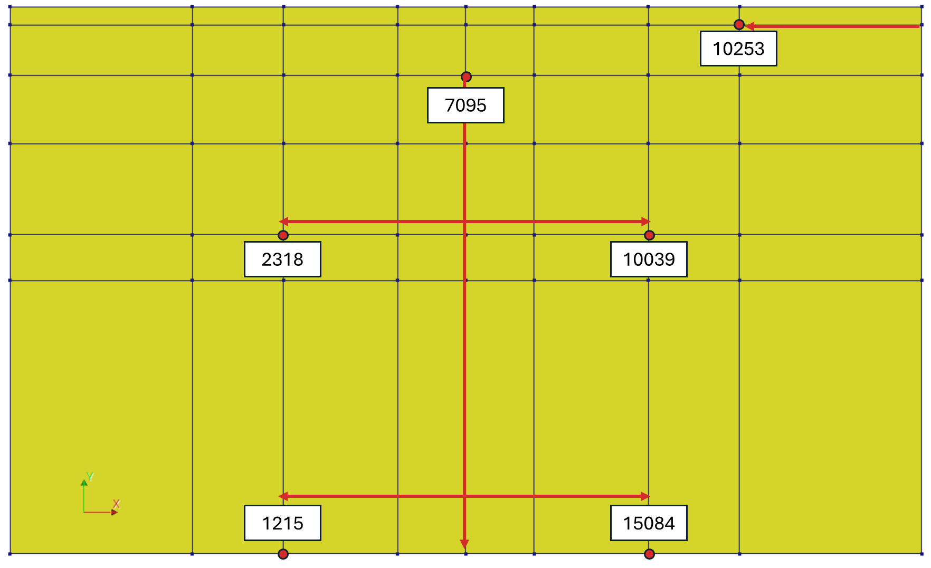



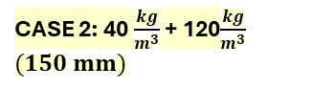
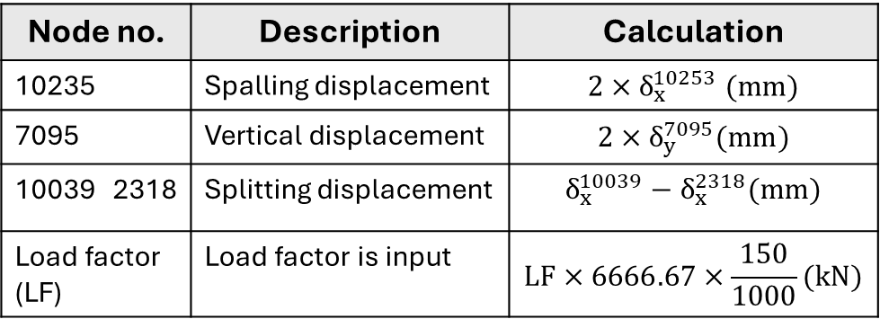
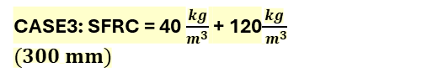
Numerical Modelling
Analysis
Nodes corresponding to the location of LVDTs
CASE 1: SFRC = 40 $kg/m^{3}$
Node no. | Description | Calculation
10235 | Spalling displacement | $$2×δ_{x}^{10253} (mm)$$
7095 | Vertical displacement | $$2×δ_{y}^{7095}(mm)$$
10039 2318 | Splitting displacement | $$δ_{x}^{10039}−δ_{x}^{2318}(mm)$$
Load factor (LF) | Load factor is input | $$LF×6666.67×\frac{150}{1000}(kN)$$
150
900
150
CASE 2: 40 $\frac{kg}{m^{3}}$ + 120$\frac{kg}{m^{3}}$
$(150 mm)$
CASE3: SFRC = 40 $\frac{kg}{m^{3}}$ + 120$\frac{kg}{{ m}^{3}}$
$(300 mm)$
Similar analysis was performed for case 2 & 3
Notes:
the cost of AR-glass textiles is about five to six times that of conventional E-glass textiles due to the incorporation of zirconia and the higher energy requirements during manufacturing.

Slide 12
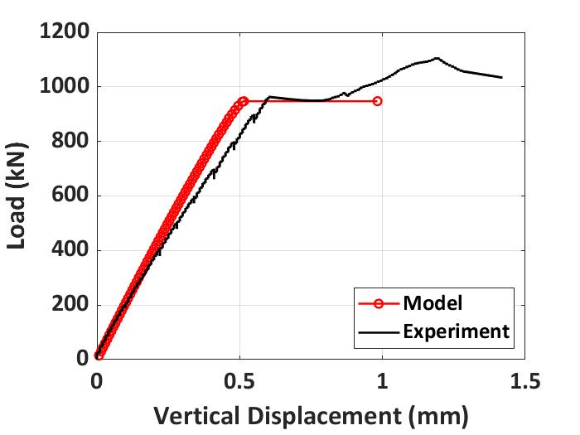
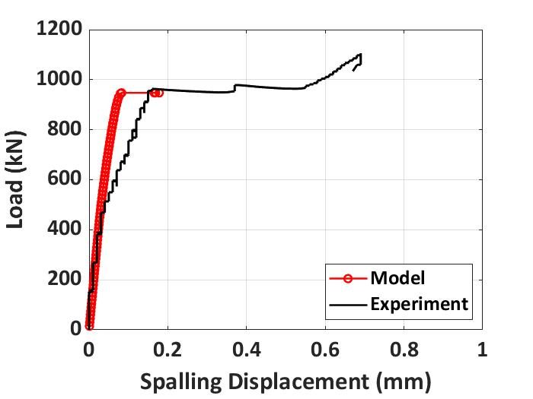
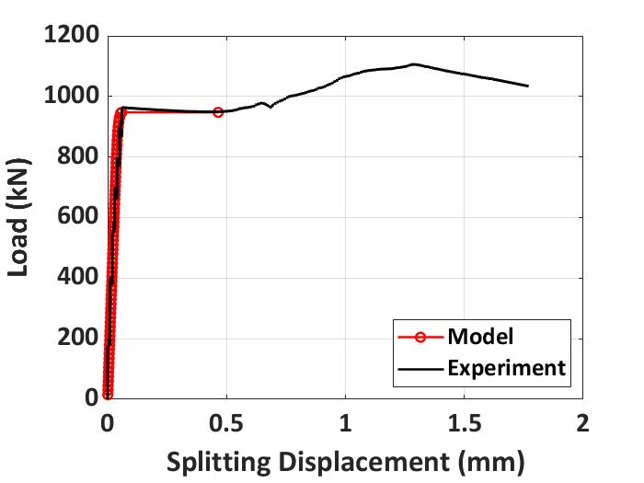
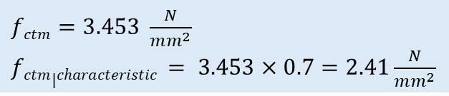

Numerical Modelling
Analysis preliminary results
$fctm=3.453 \frac{N}{mm^{2}}$
$fctm|characteristic$ $= 3.453×0.7=2.41\frac{N}{mm^{2}}$
CASE 1: SFRC = 40 $kg/m^{3}$
Good correlation with first crack load, initial modulus and horizontal portion after first crack load
Unable to capture the subsequent increase in load – convergence issues
Ongoing research – working on simulating the subsequent increase in load after the horizontal portion

Slide 13
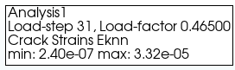
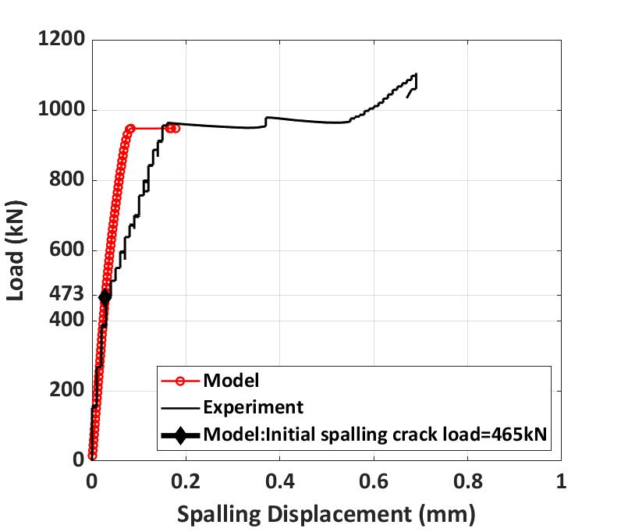
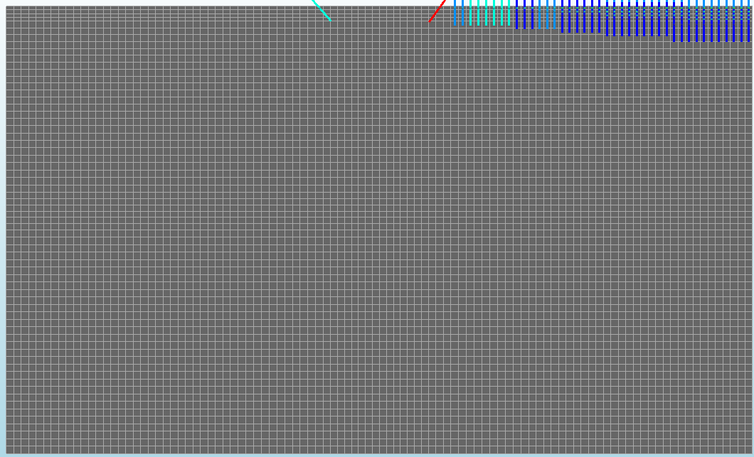
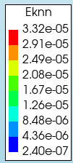

Numerical Modelling
Analysis preliminary results
CASE 1: NPFRC 40 $kg/m^{3}$
From experiments:
Initial spalling cracks occur at 473 kN
Initial splitting cracks occur at 963 kN
After further increase in load splitting failure occurs
From numerical model
Initial spalling cracks occur at 465 kN
Initial splitting cracks occur at 963 kN
After further increase in load – not captured
-1.7% difference between experimental and numerical value
Notes:
the cost of AR-glass textiles is about five to six times that of conventional E-glass textiles due to the incorporation of zirconia and the higher energy requirements during manufacturing.

Slide 14
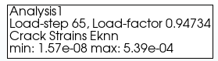
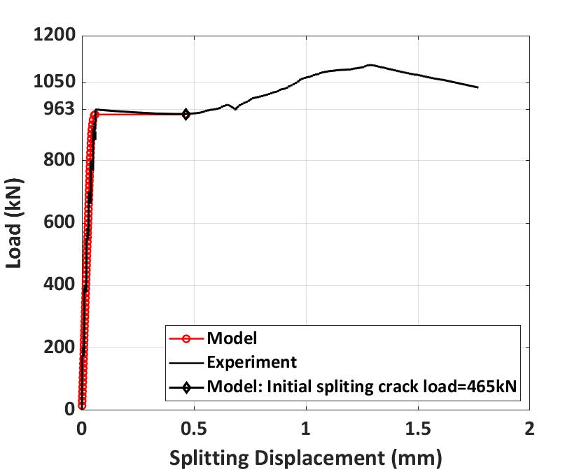
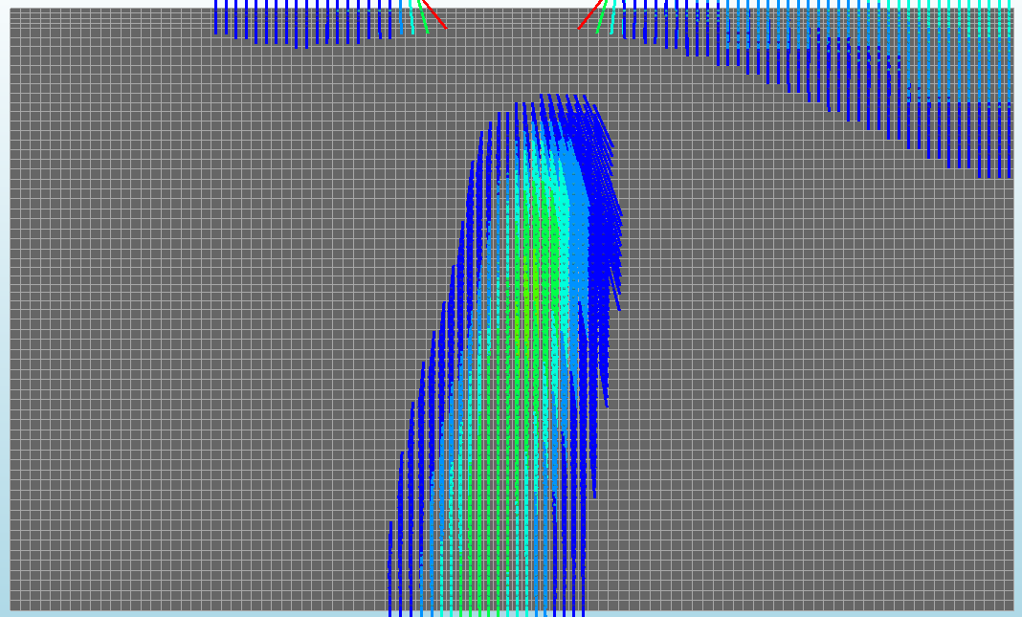
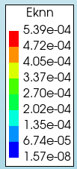
Numerical Modelling
Analysis preliminary results
CASE 1: NPFRC 40 $kg/m^{3}$
From experiments:
Initial spalling cracks occur at 473 kN
Initial splitting cracks occur at 963 kN
After further increase in load splitting failure occurs
From numerical model
Initial spalling cracks occur at 465 kN
Initial splitting cracks occur at 947 kN
After further increase in load – not captured
-1.7% difference between experimental and numerical value
Notes:
the cost of AR-glass textiles is about five to six times that of conventional E-glass textiles due to the incorporation of zirconia and the higher energy requirements during manufacturing.

Slide 15
Summary and future work
Simulation of splitting and spalling stress in SFRC segment – complex non-linear FEA
The numerical model gives good correlation with the initial modulus, first crack load and the horizontal portion after the first crack load of the experimental load-displacement curve
Numerical model has captured the initial spalling crack load and initial splitting crack load observed in the experiment
Efforts are ongoing to simulate the subsequent increase in load after the horizontal portion of the experimental load-displacement curve
Notes:
the cost of AR-glass textiles is about five to six times that of conventional E-glass textiles due to the incorporation of zirconia and the higher energy requirements during manufacturing.

Slide 16
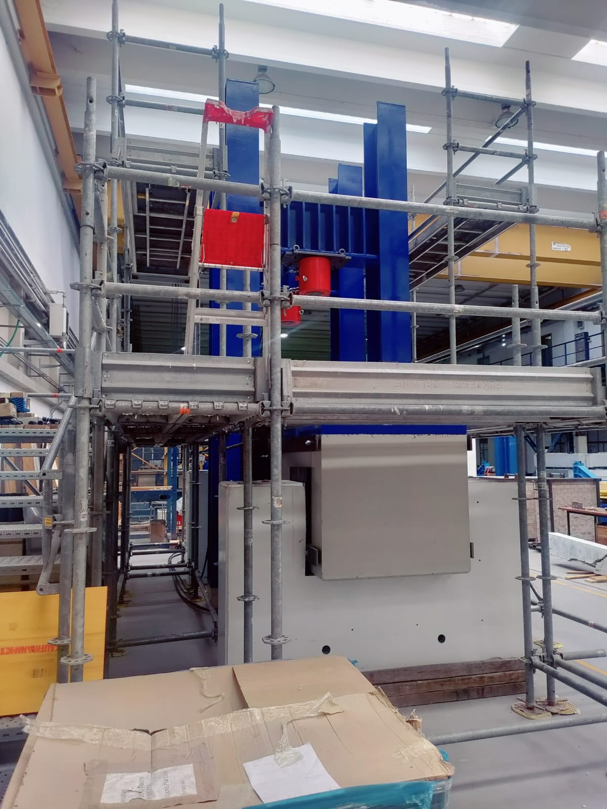
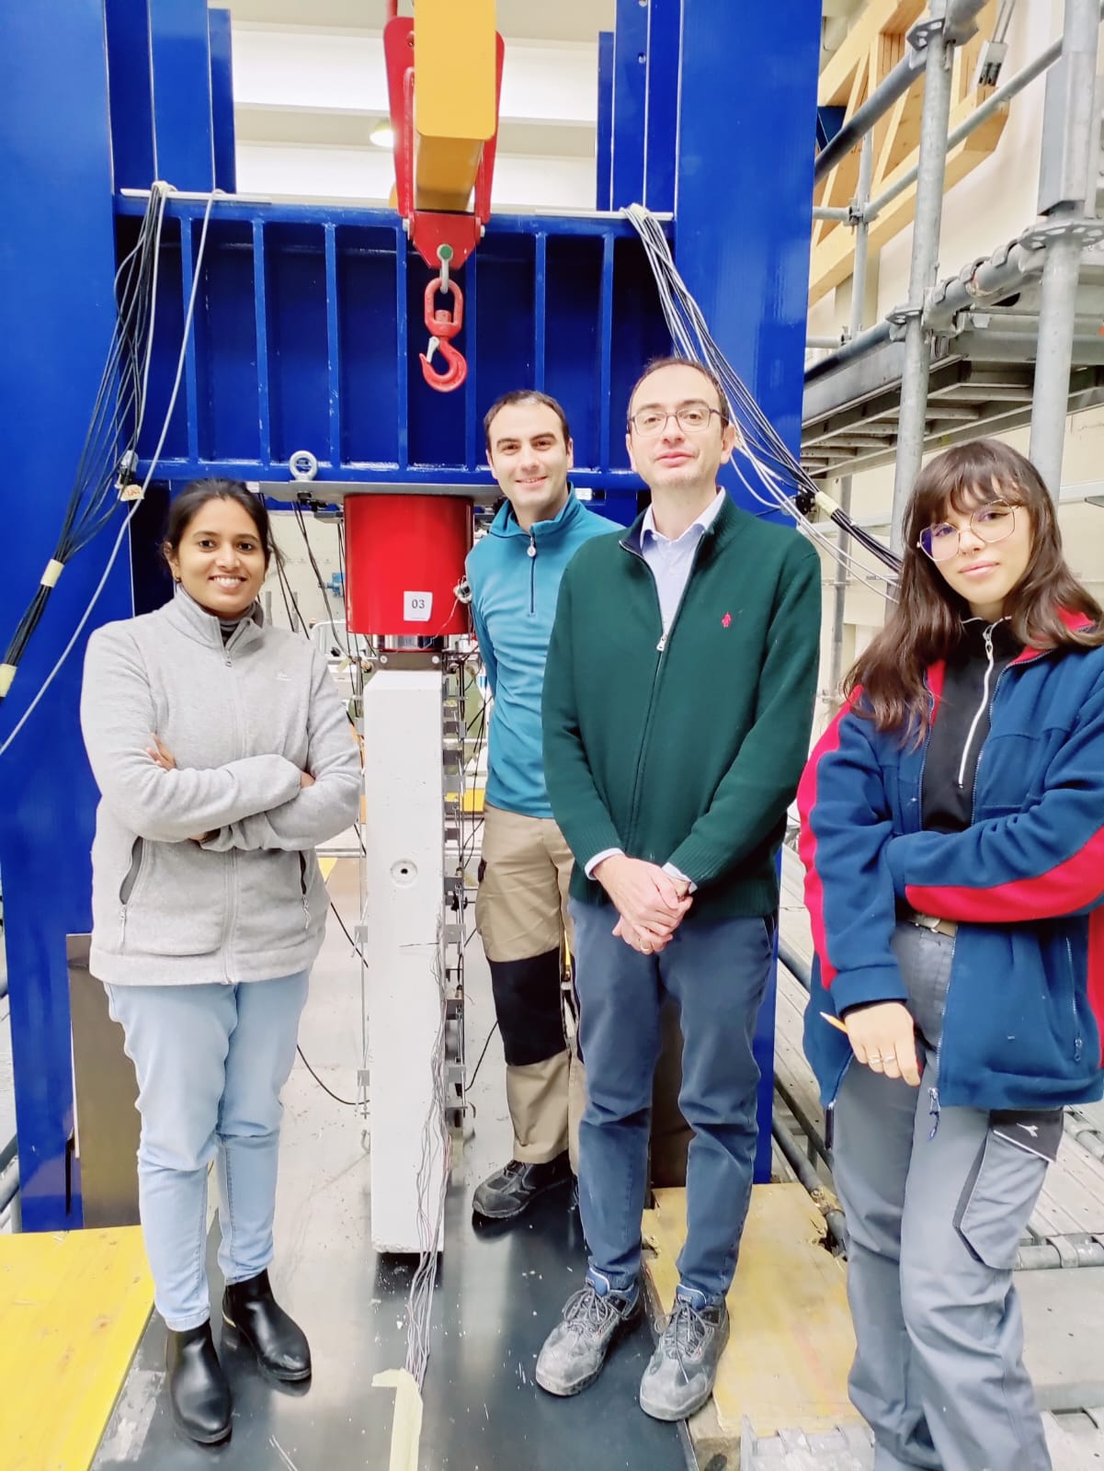


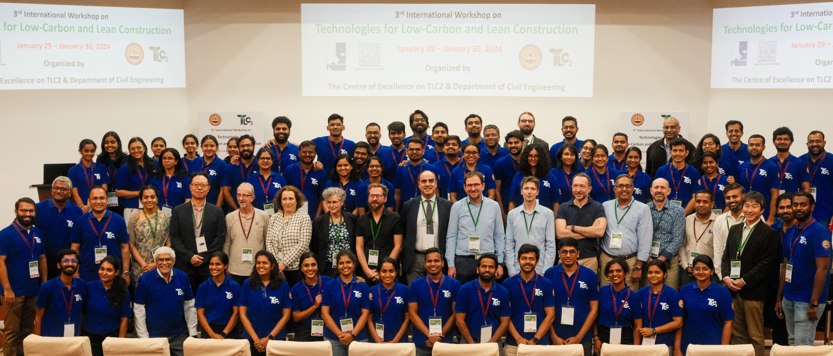

Thank you
Keerthana Kirupakaran
keerthanak@civil.iitm.ac.in

Slide 17
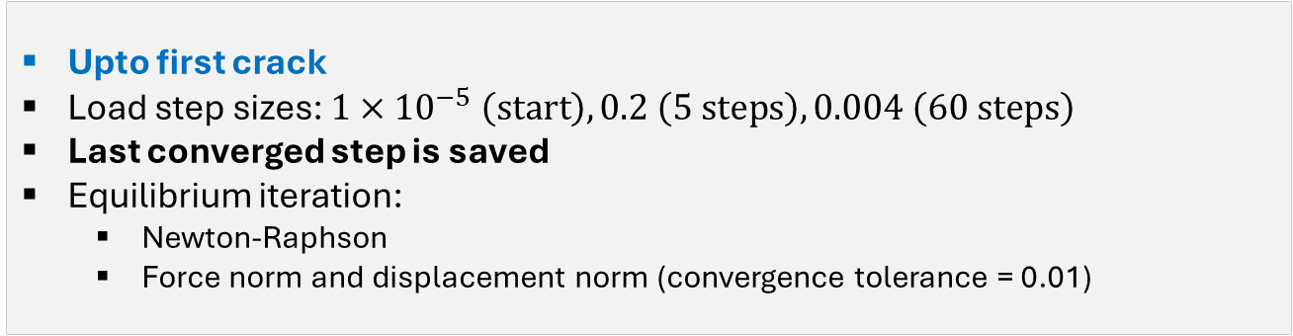


Numerical Modelling
Analysis input parameters
CASE 1: SFRC = 40 $kg/m^{3}$
Analysis
Number of load steps and step size is varied
Analysis 1
Upto first crack
Load step sizes: $1×{10}^{−5} \left(start\right),0.2 \left(5 steps\right), 0.004 \left(60 steps\right)$
Last converged step is saved
Equilibrium iteration:
Newton-Raphson
Force norm and displacement norm (convergence tolerance = 0.01)
Analysis 2
Post first crack
Load step sizes: ${10}^{−4} \left(500 steps\right)$
Equilibrium iteration:
Secant quasi-Newton
Force norm and displacement norm (convergence tolerance = 0.01)
Notes:
the cost of AR-glass textiles is about five to six times that of conventional E-glass textiles due to the incorporation of zirconia and the higher energy requirements during manufacturing.

